Slide 1
Learn like a machine
Notes:
1) How does your philosophy training help you in the data assets/IT space?
2) How does your physics background help you in the data assets/IT space?
Stance: It doesn’t have to be that way! Pull apart, put together, always know you’re most likely wrong.
3) What advice do you have for right-brained people (history and literature lovers, for example) on entering the IT space?
Figure out if you have the *aptitude* (why Joel Spolsky can’t be a bond trader). Focus on narratives. Explain things in ways that business users find appealing. Tap into empathy. Make connections.
4) What is the most interesting project Datatiq has worked on so far?
Data center readiness; groundTruth.
5) And a bit of a silly one: How did you decide on the Francis Bacon quote for your website?
Simulation is key to illuminating so many problems. Uncertainty is at the heart of simulation.
6) Through working in different types of organizations and different locations, which do you feel is the one you learned the most important things from?
Hands down it was CEB. How to work as a team. Stay humble. Stay hungry.
7) What experience was most influential in determining your career path? How did you move towards your career goals?
Very haphazardly! I always look to do what interests me the most. Most of it is being in the right place at the right time. It has not been a traditional career at all.
8) As software and automation replace jobs, is universal basic income the only fair solution, or are there others?
I don’t know. There might be other kinds of jobs. There may be no need to work (or work much less). We need a Turing-type test for the following: What can a machine NOT do?
9) R or Python? Which do you use and which would you recommend learning?
They’re both very useful. If you have to choose, learn Python first.
10) Is all data valuable?
Like work experience, a variety of data is more useful than lots of the same thing. It also depends on your objective.

Slide 2
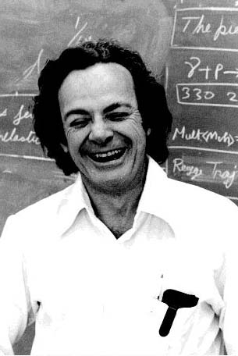
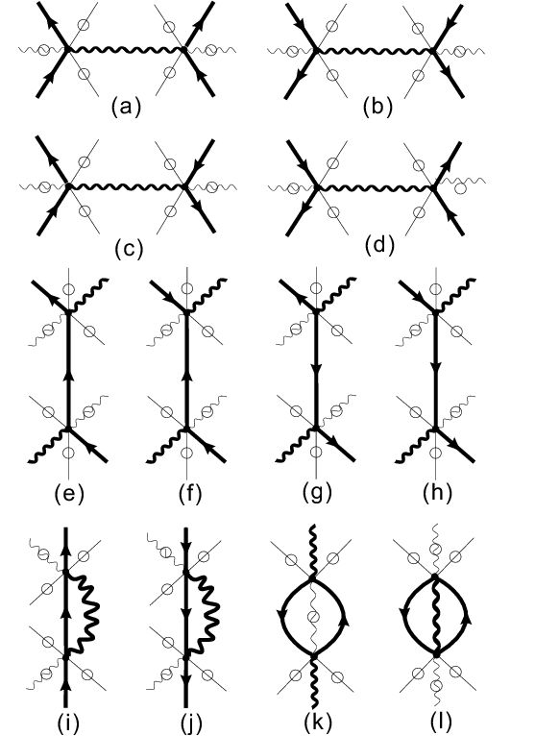
Notes:
ML is a highly theoretical field. But it’s also easy to start doing some practical things in it. So my approach is going to be the one that Feynman took in QED. To understand what it is to *do* machine machine learning – not however the techniques for doing it efficiently.
Feynman is the co-creator of Quantum Electrodynamics – along with Julian Schwinger and Sin-Itiro Tomanga. QED alters Maxwell’s laws of electricity and magnetism to accord with the laws of quantum mechanics. So it explains everything but gravity and sub-nuclear physics.
"To understand how subtraction works -- as long as you don't have to actually carry it out -- is really not so difficult. That's my position: I'm going to explain to you what the physicists are doing when they are predicting how Nature will behave, but I'm not going to teach you any tricks so you can do it efficiently. You will discover that in order to make any reasonable predictions with this new scheme of quantum electrodynamics, you would have to make an awful lot of little arrows on a piece of paper. It takes seven years -- four undergraduate and three graduate -- to train our physics students to do that in a tricky, efficient way. That's where we are going to skip seven years of education in physics: By explaining quantum electrodynamics to you in terms of what we are really doing, I hope you will be able to understand it better than do some of the students!" (page 12, Feynman, QED)

Slide 3
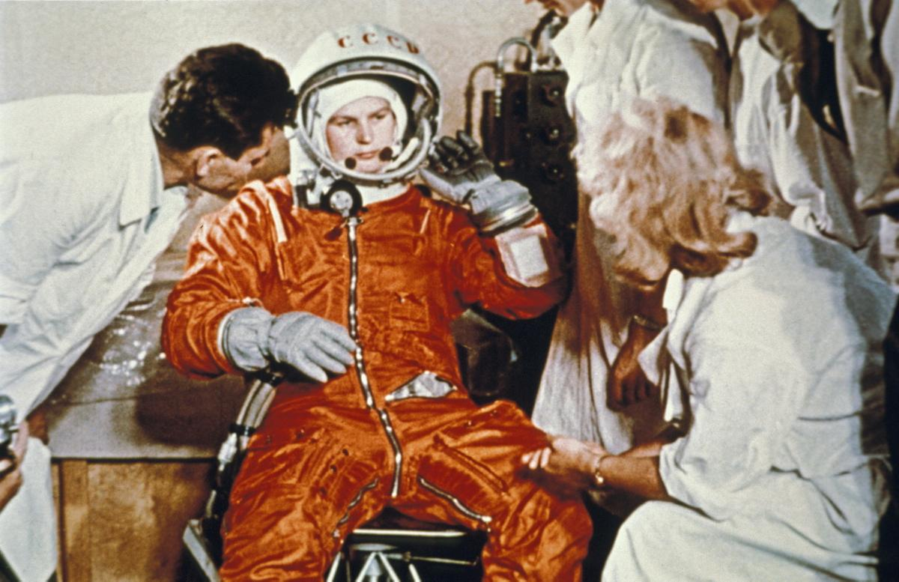
Notes:
Valentina Tereshkova with the pre-launch team. Vostok 6, June16 – 19, 1963.
When you’re on a team where you depend on other people knowing things you don’t, you have to be able to work productively with them. You don’t know everything; they don’t know everything. But together you become more than the sum of the parts.
So the second thing about the approach is to give you enough information to get started, learn more and understand it well enough so you can interact productively with your quant team.

Slide 4
Source: www.cbinsights.com
Notes:
There are lots of cool applications of machine learning in pretty much every industry. What ties these things together?
Frank Chen’s Frame for what you can do with AI (or what will happen when the following things become doable?)
Move things from point A to point B without human intervention.
See and understand the world.
Create content
Predict the future
Automatically optimize complex systems
Understand language.
Lots of data, lots of computational power, and … and what?

Slide 5
Source: www.cbinsights.com
Notes:
Clippy worked (or mostly didn’t work) because he(?) memorized a lot of rules.
…In the old days (10 years ago?) we used to do these things (or try to do them) by writing down an elaborate set of rules. But rules are a lot of work and very fragile. Lots of exceptions, lots of knowledge is needed to keep them up.
But now we do it a different way. We’ve given up on rules. To learn something without explicitly learning the rules – that’s the domain of machine learning.

Slide 6
A computer program is said to learn from experience E with respect to some class of tasks T and performance measure P, if its performance at tasks in T, as measured by P, improves with experience E.
Tom Mitchell, Machine Learning (1997)
Notes:
Experience: The images, audio, and text – rows and columns of numbers!
Tasks: convert speech to text, search and return results…
Performance: What is it? How to define it?
Performance of the learning algorithm. LEARNING PERFORMANCE
Performance of the trained model. PREDICTION PERFORMANCE
Let’s look at the kinds of experiences and tasks that are typical in machine learning. We’ll get to performance a bit later.
EXERCISE. Take any 2 applications of AI that Frank Chen mentions in his video. Specify the task as clearly as you can. What is the relevant experience? How would you measure performance on the task?

Slide 7
Images/Videos
Tasks
Label: “Motorcycle”
Summarize: “Motorcyclist turning right”
Search: Is there a helmet in this picture?
Notes:
7-time MotoGP champion Valentino Rossi. The Doctor.

Slide 8
Text
Tasks
Summarize: “Evidence leads to change of mind.”
Search: “What is a pupa?”
Generate: Write text in this style

Slide 9
Speech/Audio
Tasks
Recognize: Who’s speaking?
Identify: What’s being said?
Translate: Speak this sentence in Italian.

Slide 10
Notes:
Here’s the essence. When you boil machine learning down – this is what you get.
Have a look at this equation --
What are a1 and a2? (think Real numbers)
How would you solve this problem?
There are lots of solutions and you could spend a lot of time coming up with them!
How do you do this quickly? Is there an “intelligent” way to do it? Let’s add a bit of context…

Slide 11
Numerical
Tasks
Classify: Is person X (who is not in the data set) a smoker?
Predict: What is person X’s blood pressure?
To do these tasks well requires a large amount of data – but not necessarily big data.
Notes:
Just around 2016 “Artificial Intelligence” overtook “Big Data” on Google Trends. And it’s taken off since then leaving ”Big Data” in the dust.
(What is big data?)

Slide 12
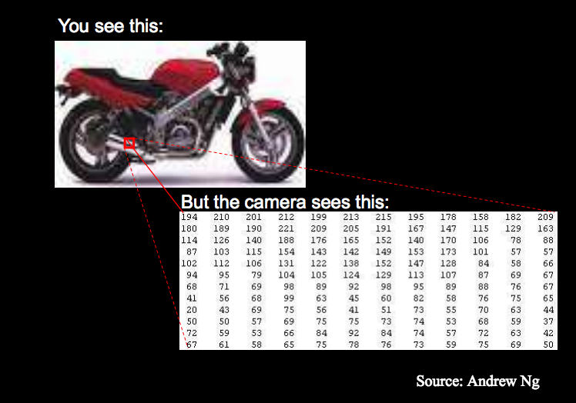
Data = A row of numbers
Dataset = A table of numbers
Inputs to a machine learning system are just tables of numbers.
Notes:
Even unstructured data is converted to a table of numbers (or matrix, or tensor).
So what do we do with these rows (and rows) of numbers?

Slide 13
One row of the dataset
Parameters
Model
Notes:
Think of this as a row of the dataset mangled together with the a’s and the arithmetic operators of multiplication and addition.
Some lingo: a1 and a2 are parameters
26, 3.8, and 62 – that’s one row of you dataset
The black rectangle is the model
Let’s put this in the context of the entire dataset…

Slide 14
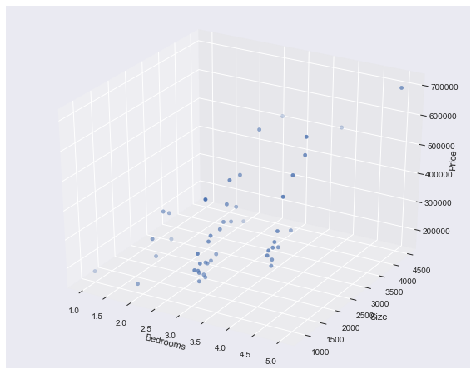
Experience (aka the Data)
Model + Data + Parameters
parameters
predictions
output
Task
Given the number of bedrooms and the size of a house, predict the price of the house.
Key Machine Learning Question
What are the right parameter values?
inputs/features
Notes:
Housing prices in Portland. Each row of this dataset has 3 numbers – size of the house, the number of bedrooms in the house and the price of the house.
The first 2 numbers in each row of the dataset are the inputs – also called the features. The price is the output.
The model is a way to get your arms around the entire data set. You apply it to every row of the dataset.
Notice that the parameters a1 and a2 are the same for each row.
What does the model do? It takes the inputs, applies the parameter values and transforms the inputs into a prediction. A prediction for each row of the dataset.
Our machine learning task is to predict the price of a house (accurately, of course) for a house that’s not in this dataset.
To do this we have to answer the key question – what are the right parameter values? What does right even mean?
This is where the notion of performance comes in…

Slide 15
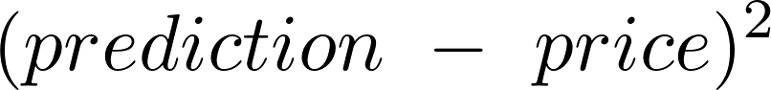
The total cost of getting it wrong – a measure of learning performance
cost of getting it wrong
Size | Bedrooms | Price | Prediction | Cost
2104 | 3 | 399,900 | 789,498 | 151,786,601,604
1600 | 3 | 329,900 | 100,022 | 52,834,894,884
2400 | 3 | 369,000 | 564,300 | 38,142,090,000
1416 | 2 | 232,000 | -345,390 | 333,379,212,100
Total Cost |  |  |  | 424,507,983,585
Goal: Find the parameters a1 and a2 that minimize total cost over the entire dataset.
Machine learning problems are giant numerical optimization problems.
Notes:
Performance is related to the cost of getting it wrong. When the parameters are not ”right” you want this cost to be large – a penalty for being wrong. The closer the parameters are to being right, the smaller the cost becomes. When you lower your cost, you improve your performance.
So our goal is: Find the parameters a1 and a2 – the values – that minimize the total cost over the entire dataset.
We need a process to do this – some organized way to do it. That way of doing it is the learning algorithm.
The “learning” part of machine learning is finding the optimal parameter values of the model.
Couldn’t do this without a computing machine AND an intelligent way to find the right answer.
The intelligent way to find the right answer is the LEARNING ALGORITHM
A giant numerical optimization problem that takes the entire dataset into account.
So what’s this mysterious learning algorithm that solves the optimization problem?

Slide 16

The cost of getting it wrong as a function of the parameter values
To learn is to get to the lowest point in the terrain. To do this consistently we need a reliable method for finding this lowest point. A common technique is Gradient Descent.
Source: Andrew Ng
Image Credit: Jason Brownlee
Notes:
The cost surface as a function of the parameter values.
A crude operational definition of learning that works surprisingly well!
Gradient descent rules!

Slide 17
Type of Data
 | Labeled | Unlabeled
Regression: Predict a Real number
Classification: Predict it belongs in X rather than Y
The emphasis is on the learning algorithm rather than the model
Type of Prediction
models
Models are determined by the type of data you have and the type of prediction you’re looking to make.
Notes:
Your data can be labeled or it can be unlabeled.
You can predict a Real number; or classify things so each falls into one of a fixed number of categories.
Let’s unpack these expressions to get to some key concepts.

Slide 18
parameters
features
Use to predict a real number: regression
Linear combination by multiplication and addition; 2 unknown parameters; number of features are usually ~ 100s or more; # parameters = # features
Structure
Non-linear combination by exponentiation, multiplication and addition; 2 unknown parameters; number of features are usually ~ 100s or more; # parameters = # features
Use to classify
It’s easy to make non-linear models using the same basic structure; these are 3rd order models with 5 features, hence 5 parameters
Predict a number (continuous) or predict a class (discrete). That’s what prediction is in machine learning.
Note: There is actually one additional parameter (and a corresponding feature that’s always equal to 1) in the models above. I’ve left it out to keep the expressions simpler.

Slide 19
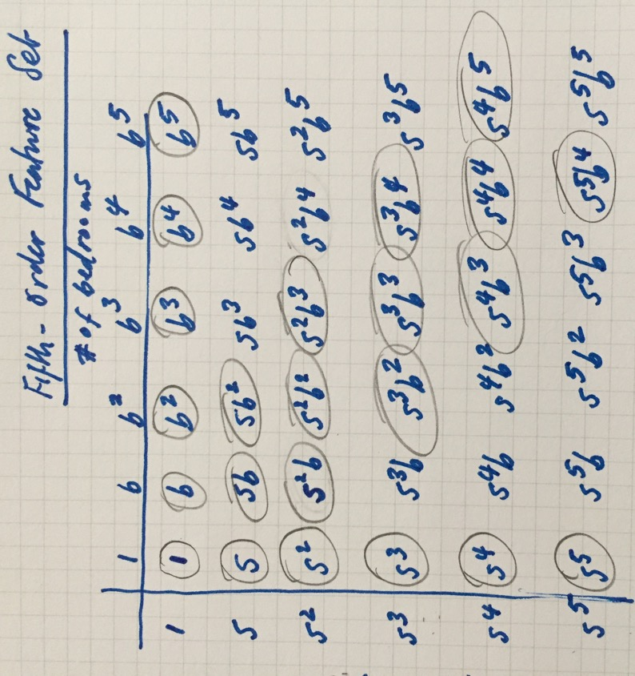

Slide 20
Learning System = Model + Cost Function + Method for Finding Optimal Cost
Source: Andrew Ng
What is the structure of the model?
What kinds of features should we use?
How many features?
Linear or non-linear?
What’s the right cost function?
What’s the right algorithm for finding the optimal cost?
How much data should be used on each iteration?
To what degree should the features be discounted (regularized)?
What should the learning rate be?
How many learning iterations?
What’s the right measure of system performance?
Notes:
Let’s put the pieces together.
Hyperparameters are in orange.
Machine learning requires figuring out the right choices of model structure and details, fixing a cost function, fixing an algorithm for finding the optimal cost. On top of that, you need to tune the model by tuning the hyperparameters.
First timers are often surprised by how little time they spend actually getting the machine to learn.
“Often the raw data is not in the form that is amenable to learning, but you can construct features from it that are. This is typically where most of the effort in a machine learning project goes. It is often also one of the most interesting parts, where intuition, creativity, and “black art” are as important as the technical stuff.”

Slide 21
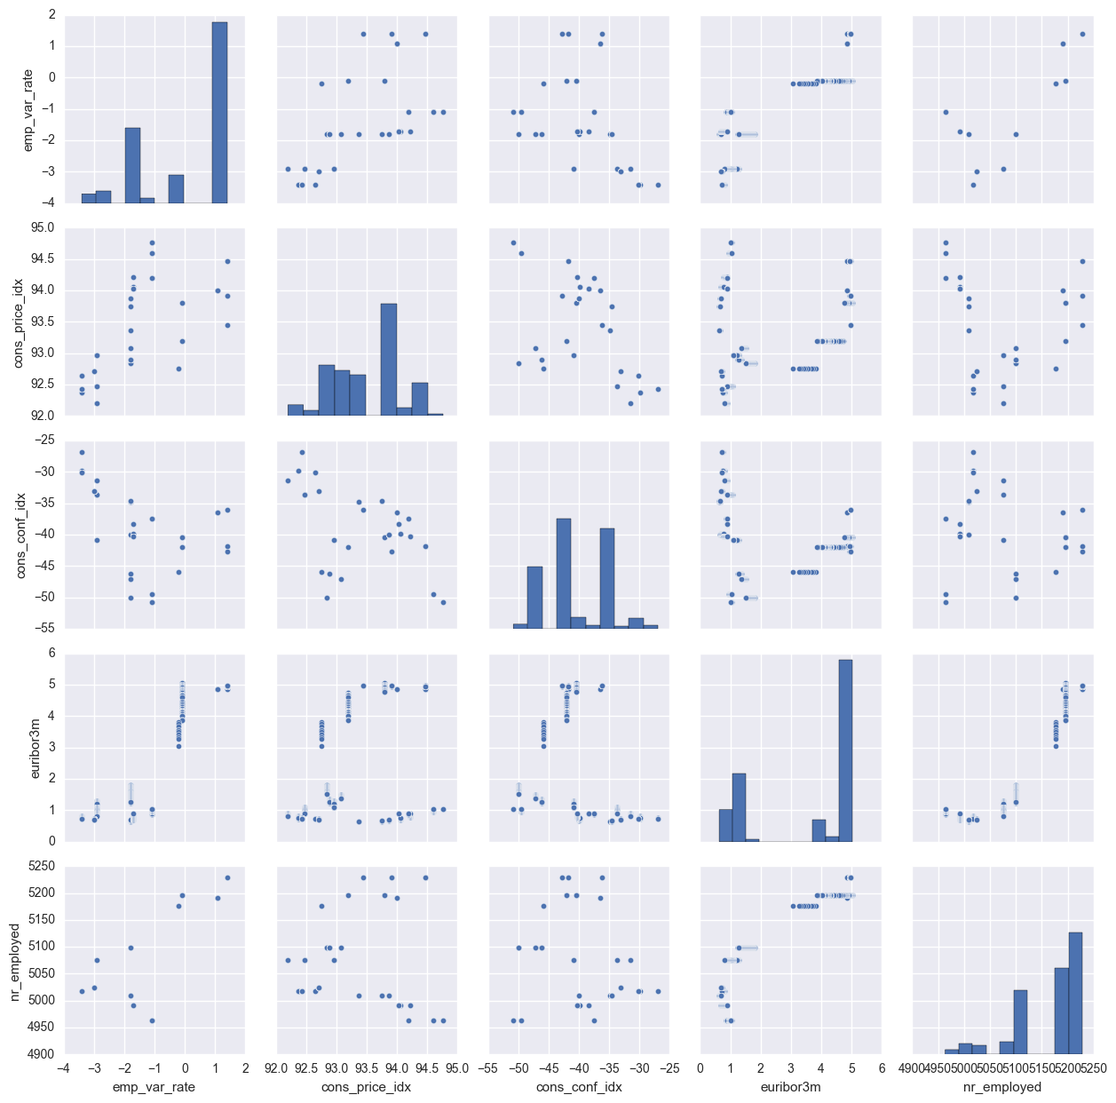
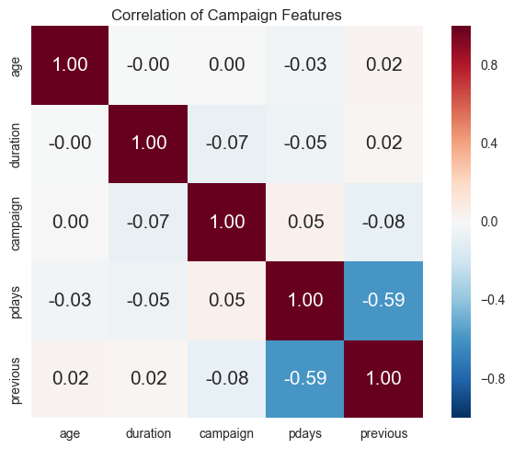
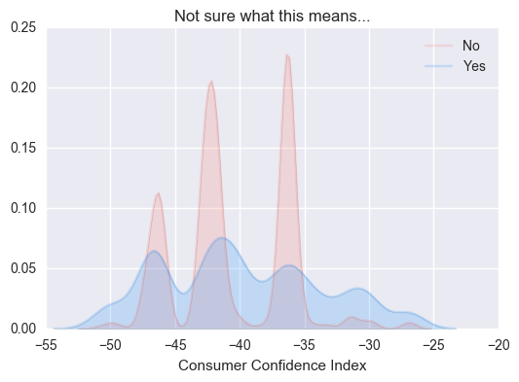
Source: Portuguese Bank Marketing Data Set, https://archive.ics.uci.edu/ml/datasets/Bank+Marketing
Notes:
What happened to our old-fashioned data analysis?
We no longer think about cross-tabs, correlations, and hypotheses to test.
Or thought provoking conclusions…

Slide 22
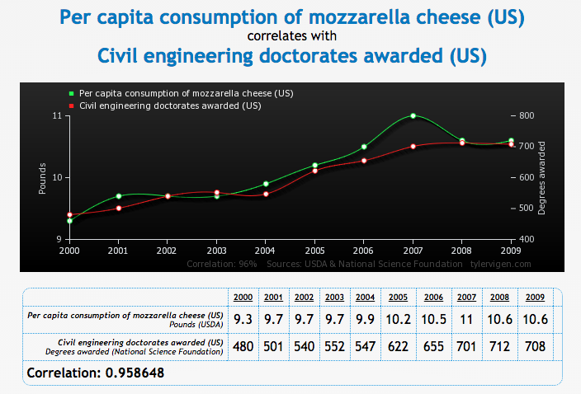
Source: tylervigen.com/old-version.html
Notes:
Also see https://xkcd.com/882/ (Significant)
What then? What exactly do you do when you do machine learning? Well, it’s back to our list...

Slide 23
Are we predicting a number or a class?
What kinds of features should we use?
How many features?
Linear or non-linear?
How do you take the available data and translate it into a form that can be fed into a machine learning system?
How do you know you’re not learning too little or too much?
What’s the right measure of my learning system’s performance?
What’s the right cost function?
What’s the right algorithm for finding the optimal cost?
How much data should be used on each iteration?
To what degree should the features be discounted (regularized)?
What should the learning rate be?
How many learning iterations?
This is where you can exercise creativity even if you’re not knee deep in the model building and manipulation.
Notes:
What data do you use?
How do you get data into the right “machine learning” format?
How do you know you’re not learning too much or too little?
How do you measure the performance of your learning system?
Instead of our old fashioned data analysis, here’s what we do instead.
A systematic way to answer the question of system performance is to use the concepts of BIAS and VARIANCE.
So what are bias and variance? Only the two most important concepts ever in machine learning!
But first, a look at the data.

Slide 24
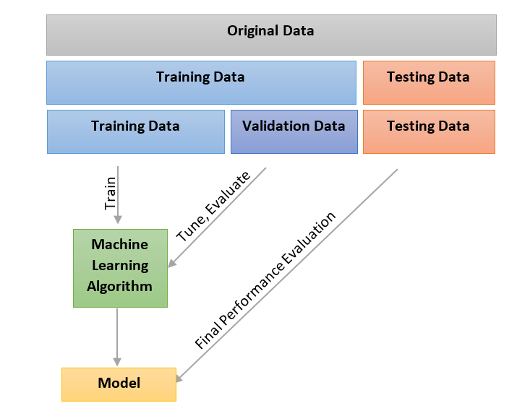
Notes:
Two main questions:
What data should you use (which features)? (Related question: How do you get your data into the form that’s ready for machine learning?)
How do you know you’re not learning too much or too little?

Slide 25
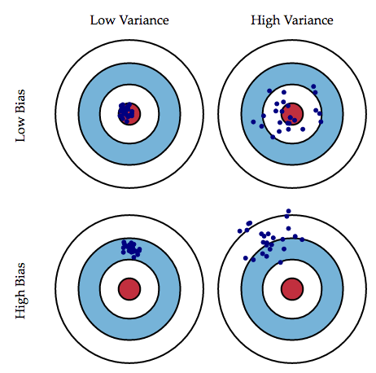
Bias and Variance for Regression Problems
High Variance
High Bias
Source: http://stackoverflow.com/questions/17128847/plotting-polynomials-of-best-fit
Source: Scott Fortman-Roe, http://scott.fortmann-roe.com/docs/BiasVariance.html
Notes:
How do you know your learning system is good? It must generalize well. In other words, it must do well on the test set.
We measured learning performance. But how do we measure the performance of a system that is already trained and is making predictions?
The way to measure system performance is to measure bias and variance. The only way to measure these is to separate the training data from test/cross-validation data.

Slide 26
Bias and Variance for Classification Problems
Right Balance of Bias & Variance?
High Variance?
High Bias
Source: http://stackoverflow.com/questions/22294241/plotting-a-decision-boundary-separating-2-classes-using-matplotlibs-pyplot
Source: http://openclassroom.stanford.edu/MainFolder/DocumentPage.php?course=MachineLearning&doc=exercises/ex8/ex8.html
“Prediction is hard, especially about the future.” – you know who
Notes:
Bias is a learner’s tendency to learn too little and hence predict the wrong thing most of the time.
Variance is the tendency to learn too much – irrelevant things and hence predict the wrong most of the time.
Contrary to intuition, a more powerful learner is not necessarily better than a less powerful one.
Key Question: IF the world is different in just a small way, how well does your classification hold up?

Slide 27
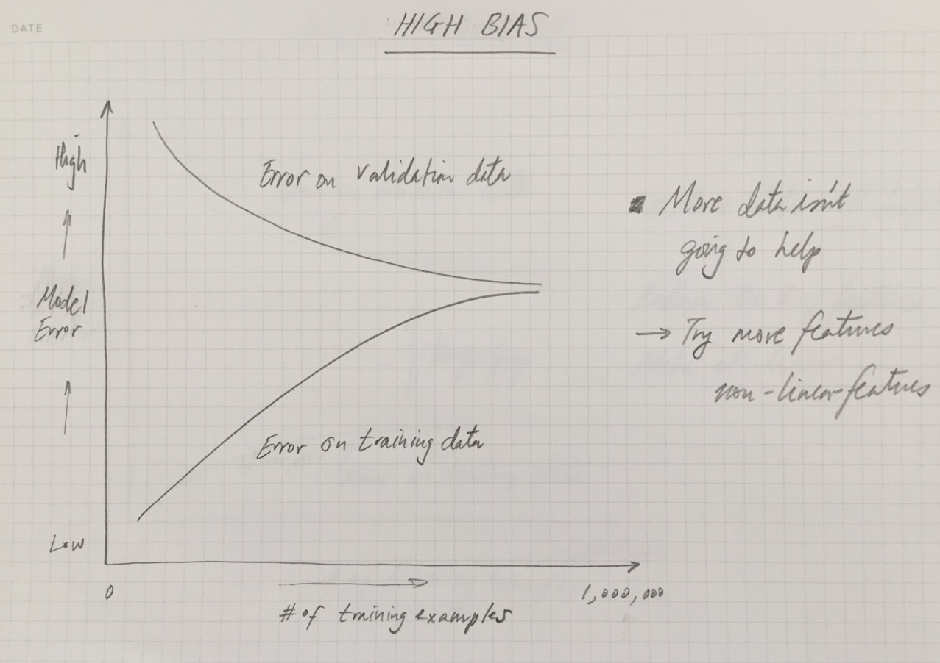

Slide 28
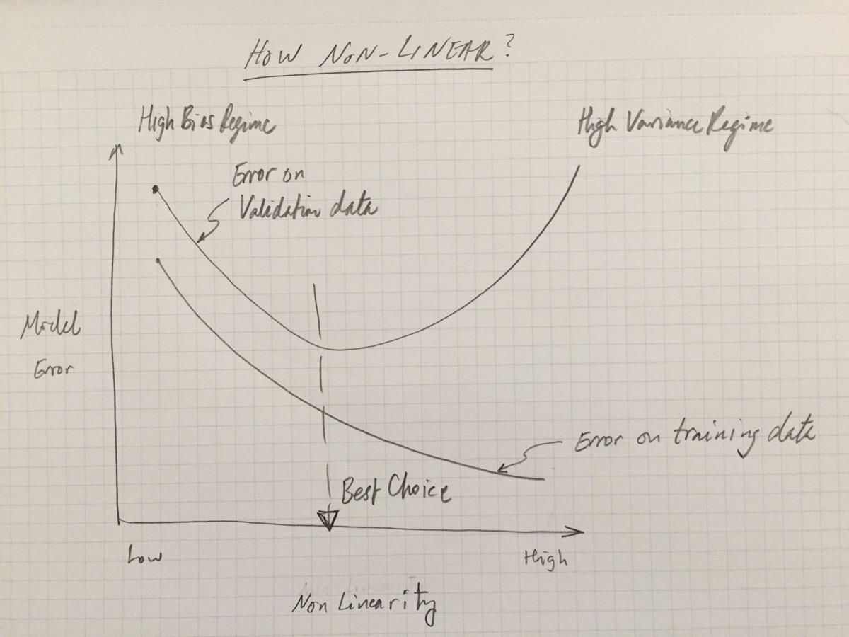

Slide 29
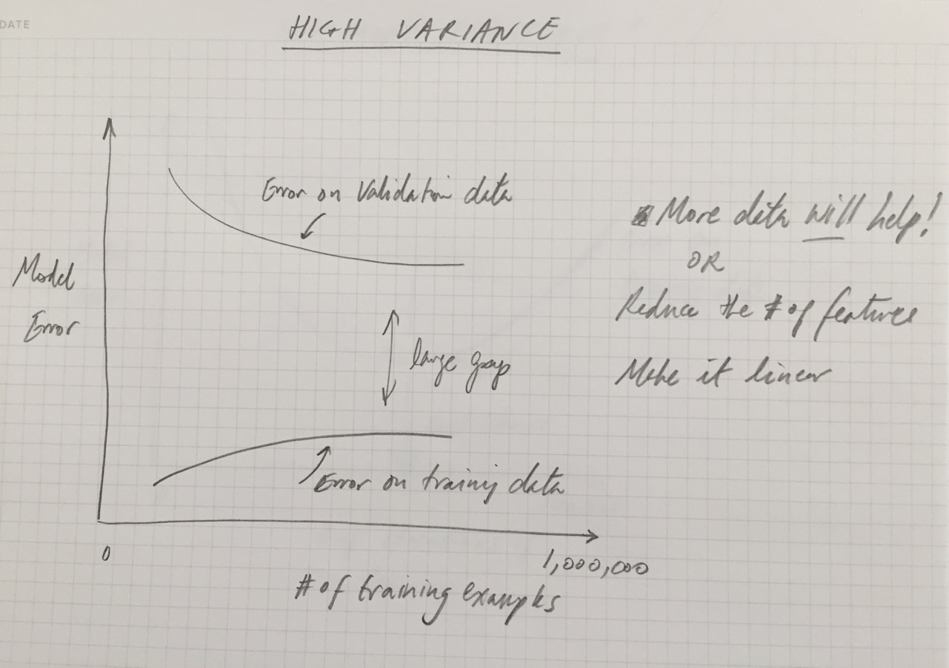

Slide 30
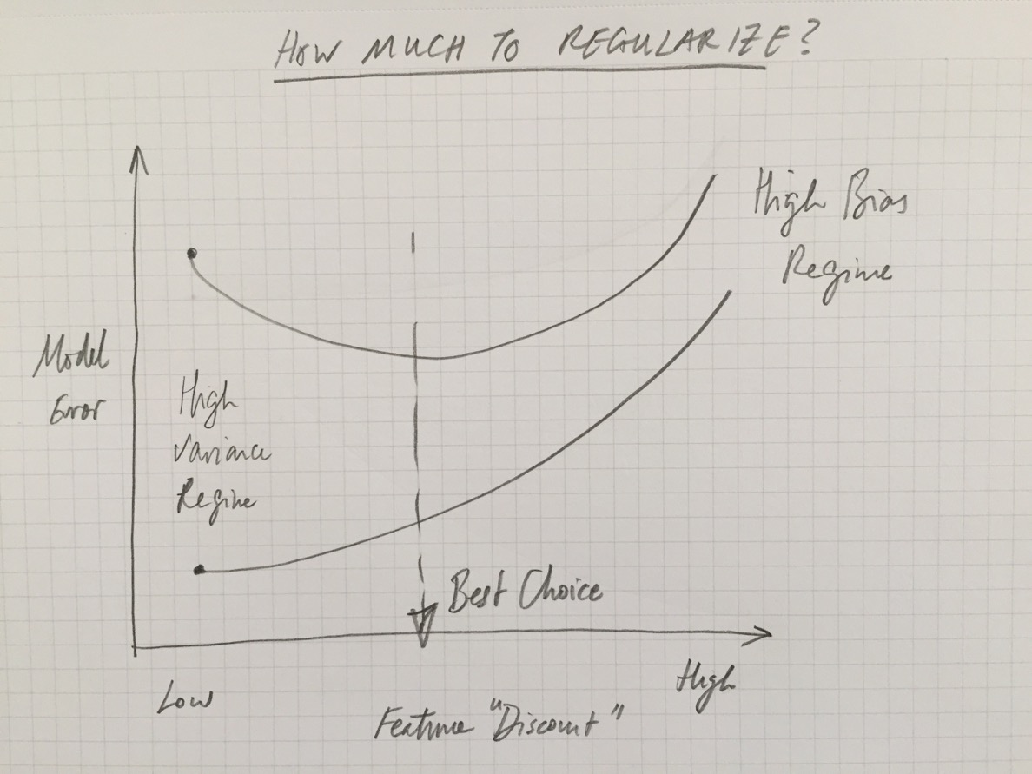

Slide 31
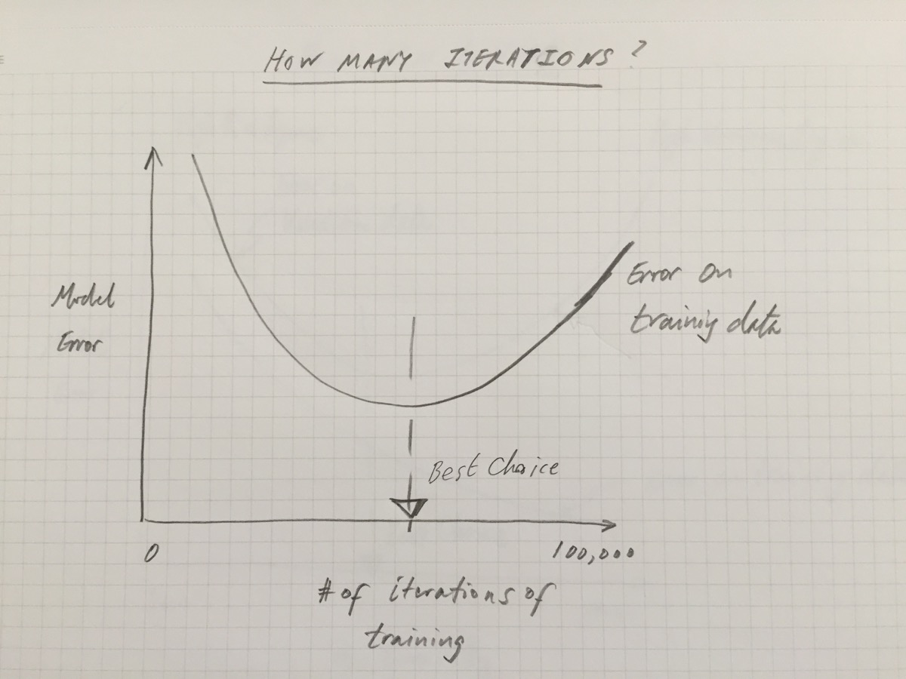
Notes:
Actually, this one is about the learning rate – not the 3 of iterations.

Slide 32
Imbalanced Data
“Learned Model”: Predict terrorist if person is named Tim
Assumptions:
1 in 1,000 people are named Tim
1 in 100,000 people are terrorists
1,000,000 people screened
 | Terrorist | Not Terrorist | Total
Tim | 1 (True Positive) | 999 (False Positive) | 1,000
Not Tim | 9 (False Negative) | 998,991 (True Negative) | 999,000
Total | 10 | 999,990 | 1,000,000
(1 + 998,991)/1,000,000 = 0.998992
99.89% accurate!
0.1% precision
Source: https://en.wikipedia.org/wiki/Precision_and_recall
1 /999 = 0.001001
Prediction accuracy is not always the right measure of system performance. Watch out for imbalanced datasets!
10% recall
1 /(1 + 9) = 0.1
Notes:
Once you’re convinced you’re not learning too little or too much, you’re ready to ensure that the learning system’s performance is measured correctly. One thing to watch out for is a dataset with imbalanced labels.
What happens when classes are imbalanced? The right measure of model performance needs to be thought through.
The main things to deal with:
Overfitting and underfitting
Imbalanced data categories
The curse of dimensionality
Learning to quickly or too slowly – knowing when to stop
Using a single model – not trying out a few models
Keeping the test set protected – using validation and cross validation

Slide 33
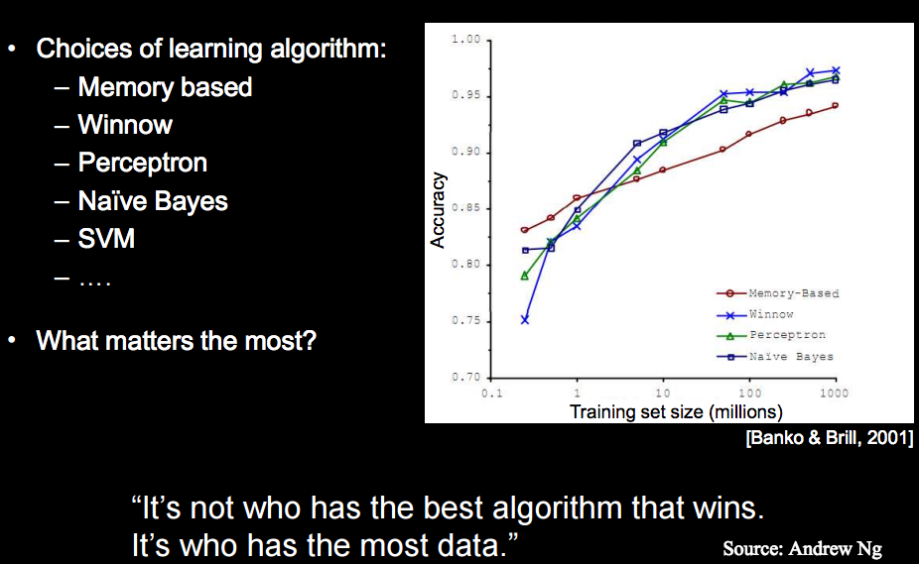
Notes:
A lot of time is spent cleaning the data and getting it into shape. A lot of time is spent on choosing the models and making them more sophisticated (more features, non-linear, clever cost function, etc.).
However, … data is the big equalizer. (Although, remember, it alone is not enough. No one said life was easy or fair.)

Slide 34
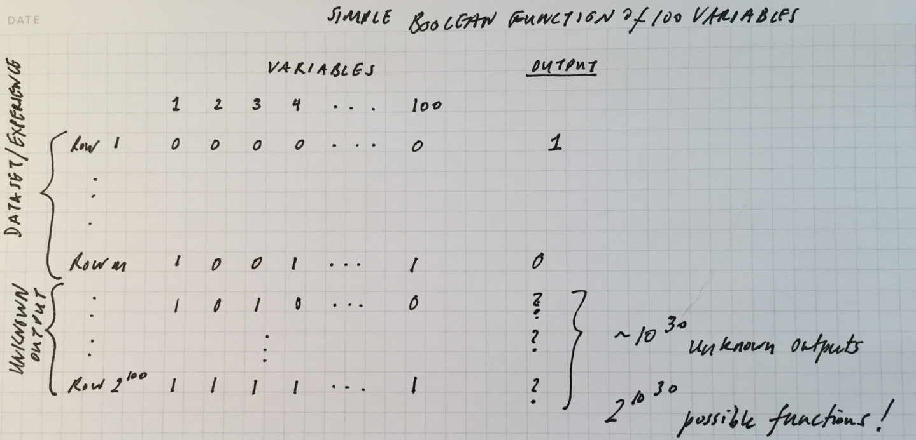
Data alone is not enough
rows to define the function
Problem: Even if you have a trillion rows of data to learn from, you still need to learn rows!
“Luckily, the functions we want to learn in the real world are not drawn uniformly from the set of all mathematically possible functions!” (Pedro Domingos)
Notes:
“In the absence of further information, there is just no way to do it that beats flipping a coin.” (Domingos, p.3)

Slide 35
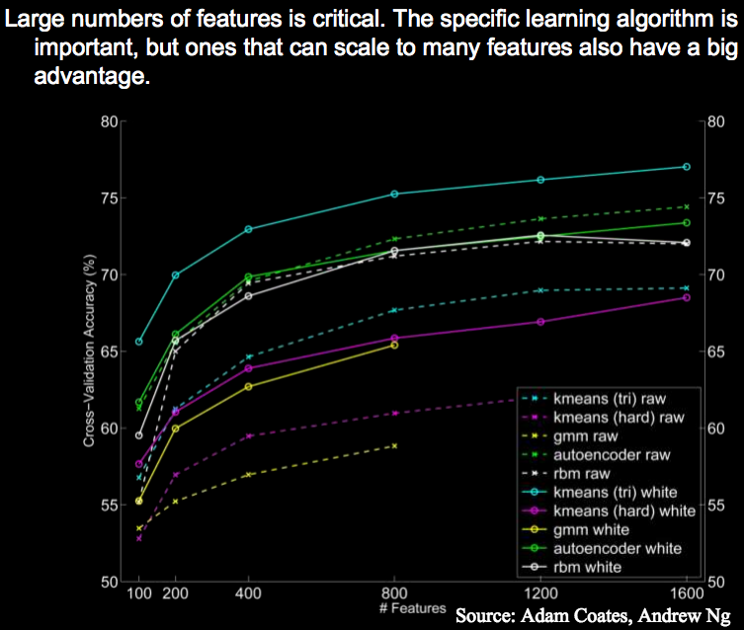
Notes:
At the end of the day, some machine learning projects are successful and some fail. What makes the difference? Easily the most important factor is the features used.
There’s ultimately no replacement for the smarts you put into feature engineering.
Or is there? Can it be automated/learned in some way?

Slide 36
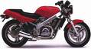
handle
Feature representation
Learning
algorithm
wheel
Input
Motorbikes
Input space
Feature space
“Non”-Motorbikes
“handle”
pixel 2
pixel 1
“wheel”
Notes:
Feature representation is hand crafted.

Slide 37
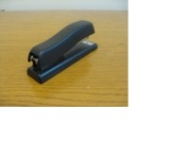
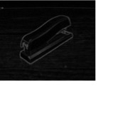
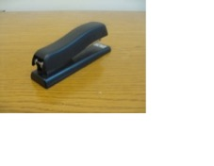
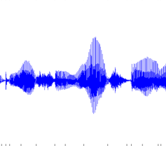
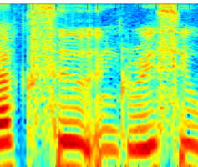

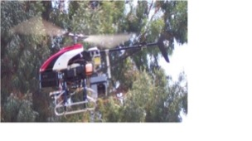
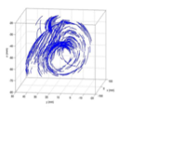
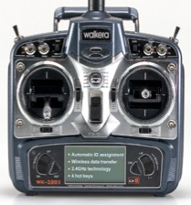
Object detection
Image
Low-level
vision features
Recognition
Audio classification
Audio
Low-level
audio features
Speaker
identification
Problems of hand-tuned features
1. Need expert knowledge
2. Time-consuming and expensive
3. Does not generalize to other domains
Helicopter control
Low-level state
features
Helicopter
Action
Notes:
How computer perception is done today

Slide 38
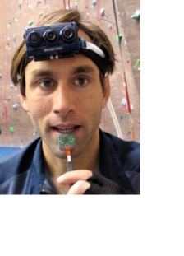
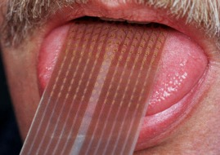
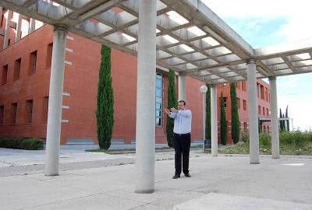
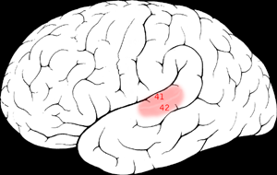
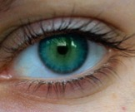
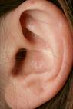
The One Learning Algorithm Hypothesis
Seeing with your tongue
Sensory cortex learns to see.
Human echolocation (sonar)
Auditory cortex learns to see.
Auditory
Cortex
Source: Andrew Ng; BrainPort; Martinez et al; Roe et al.

Slide 39
Universality Theorem: A three-layer neural network can calculate any function (to a close approximation).
CAUTION: That a function can be calculated doesn’t mean it can be learned.
Check out Michael Nielsen’s online book for more information: http://neuralnetworksanddeeplearning.com/chap4.html
Source: GoogleBrain
Notes:
“One of the holy grails of machine learning is to automate more and more of the feature engineering process.” (Domingos, p.6)

Slide 40
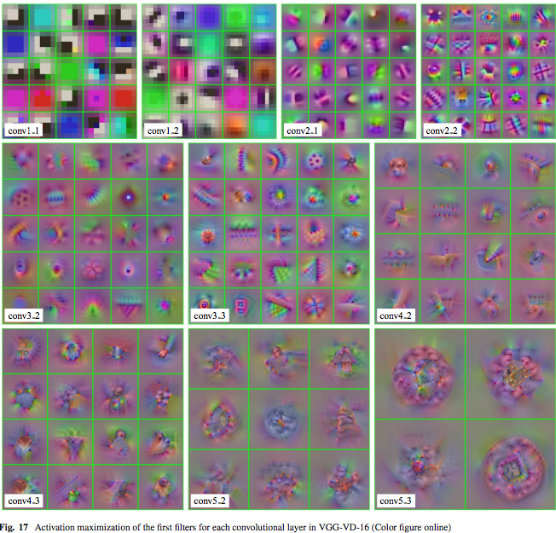
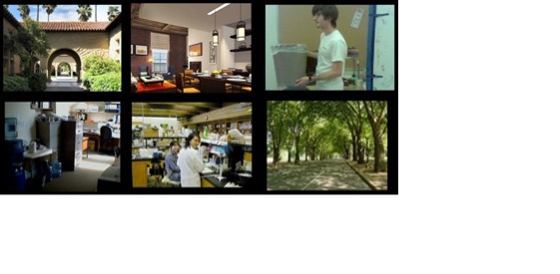
The goal of unsupervised feature extraction
Unlabeled images
Learning
algorithm
Feature representation
Source: Andrew Ng; Mahendran and Veldadi 2015

Slide 42
Source: McKinsey Quarterly, July 2016

Slide 43
“I must study politics and war that my sons may have liberty to study mathematics and philosophy. My sons ought to study mathematics and philosophy, geography, natural history, naval architecture, navigation, commerce, and agriculture, in order to give their children a right to study painting, poetry, music, architecture, statuary, tapestry, and porcelain.”
-- John Adams, 1780

Slide 44
Source: www.cbinsights.com

Slide 45




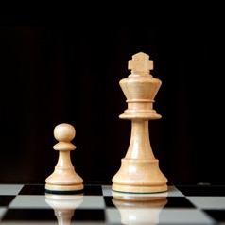


Perception
Learning
Reasoning
Abstraction
Rules–Based Systems
No
No
Yes
No
Machine Learning
Yes
Yes
No
No
Deep Learning
Yes
Yes
No
Yes
Contextual Adaptation
Yes
Yes
Yes
Yes
Notes:
The components of intelligence.
Situations where you can’t specify the rules explicitly.
Knowing that, knowing how, and knowing why.

Slide 46
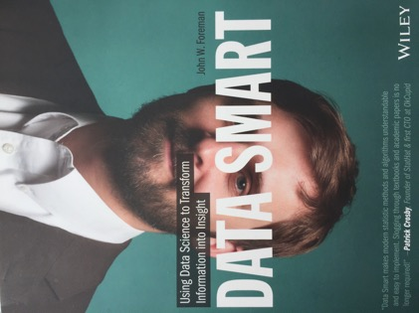

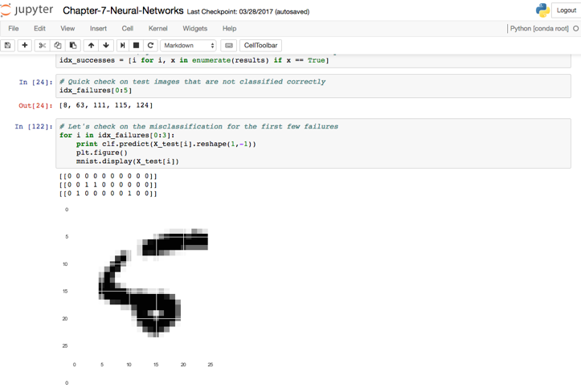
Jenn Wortman Vaughn
Daphne Koller
Andrew Ng
Adam Geitgey
Jason Brownlee
Sonya Sawtelle
Michael Nielsen
Chris Olah
Andrej Karpathy
Hilary Mason
Datasets
Kaggle
UCI ML Repository
Open Data for Deep Learning

Slide 47
“Organizations that make the most of machine learning are those that have in place an infrastructure that makes experimenting with many different learners, data sources and learning problems easy and efficient, and where there is a close collaboration between machine learning experts and application domain ones.”
Pedro Domingos, A Few Useful Things to Know About Machine Learning.

Slide 48
“More broadly, companies must have two types of people to unleash the potential of machine learning. ‘Quants’ are schooled in its language and methods. ‘Translators’ can bridge the disciplines of data, machine learning, and decision making by reframing the quants’ complex results as actionable insights that generalist managers can execute.”
An executive’s guide to machine learning, McKinsey Quarterly, June 2015
Notes:
Not just reframing the results but framing the problem correctly too.
E.g. how to take EMBERS data and connect it to business disruption?
How to take make, model, and year and predict the used-car’s price?

